Slide 1
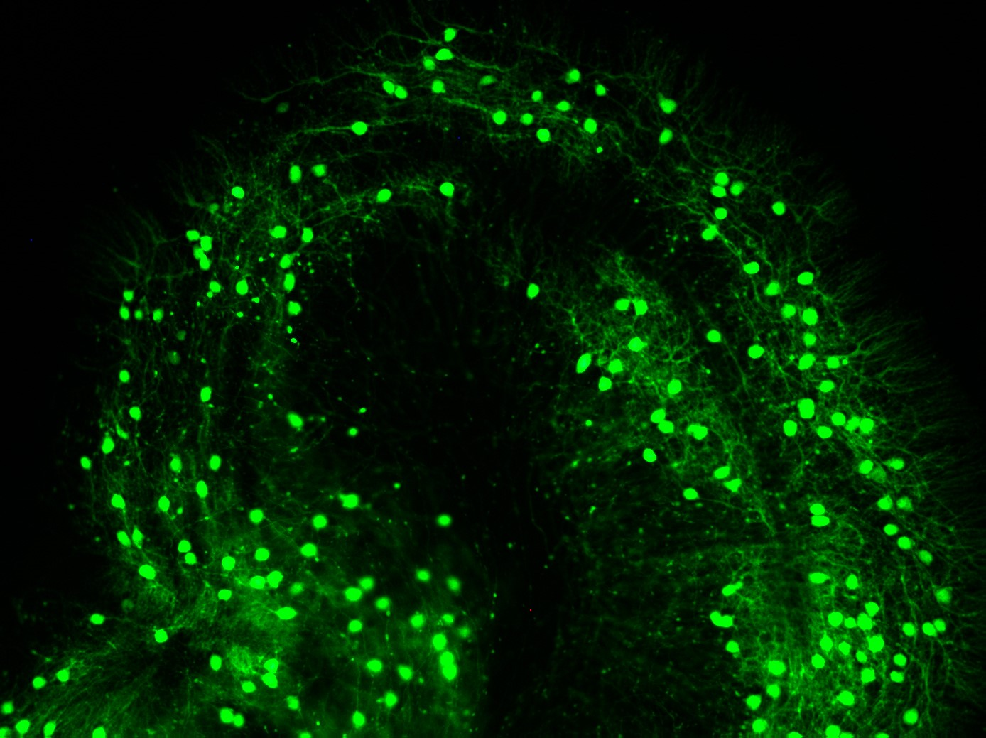
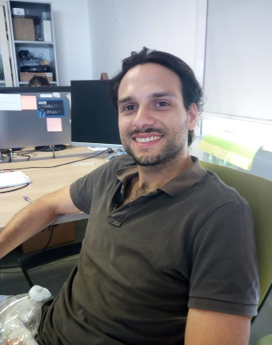


Brain micro-architecture:
from clarified tissues to single neuron isolation
A framework for the isolation of single neurons: integration of clarification methods and open source tools for image segmentation
Accurately mapping the brain at the micro-scale is still a challenge in cellular neuroscience. In recent years, new-tissue clearing techniques coupled with well-established microscopy imaging methods (e.g. confocal and two-photon microscopy) enabled to acquire volumetric data of the global arrangement of large brain neuron populations at the cellular resolution. On the other hand, several algorithms for automatic neuron segmentation aiming at obtaining accurate morphological and topological organization of neurons have been proposed. Notable success have been reach in both fields. However, their integration has been poorly conceived. As a result, an entire new class of clarified images are available, but algorithms purposely developed to deal with such images are still lacking. In this seminar, we will present a new framework for the analysis of neuron morphology, integrating the optimization of clarification methods with purposely developed open source tools for the segmentation of single neurons from clarified microscopy data.
Alejandro Luis Callara is a PhD candidate in the Dipartimento di Ingegneria dell’Informazione and in the Research Center “E. Piaggio” at the University of Pisa. He received his master’s Degree in Biomedical Engineering in 2015 from the University of Pisa, Italy. His PhD thesis and research activity are related to models, methods and pipelines for biomedical signal and image processing using EEG and fMRI. He also collaborates, as part of the Brain matters team in the DataBrain project developing tools, algorithms and models for the segmentation of single neurons from clarified confocal microscopy data.
Giovedì 24 Gennaio, ore 15,30/17,00
Aula Pacinotti

